Slide 1
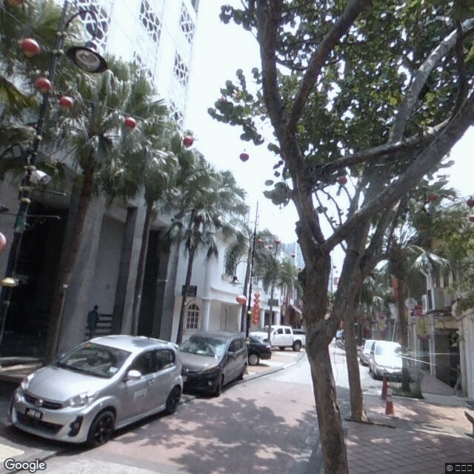

Urban Analytics on Green Coverage in Malaysia with Street View Images
Project 1
Proposal by: Chong Xian Jun
Supervisor: Ts. Dr. Chan Weng Howe

Slide 2
Problem Formulation
Lack of comprehensive regulations on urban green space planning as the current ones only focus on the reservation of open spaces.
The urban green spaces are not planned and designed to optimize the user experience in the urban environment.
Quantitative study with metric to measure the experience of a city’s inhabitants with urban greens.
How much green can people in Malaysian city see?
Quantitative metric
- Green View Index (GVI)
Limited relevant researches with existing urban green research in Malaysia being not relatable to the daily experience of urban inhabitants.
Problem Background
Problem Statement

Slide 3
Aim and Objectives
Aim:
To analyze the state of urban green coverage in Malaysian city from the users' perspective with Green View Index (GVI).
Objectives
To collect and process street view images data to measure urban green coverage from the perspective of human users.
To compute GVI effectively from street view images with unsupervised segmentation and supervised machine learning models.
To develop a dashboard to visualize the estimated GVI of selected sites and assess the distribution of green views in Malaysian city.

Slide 4
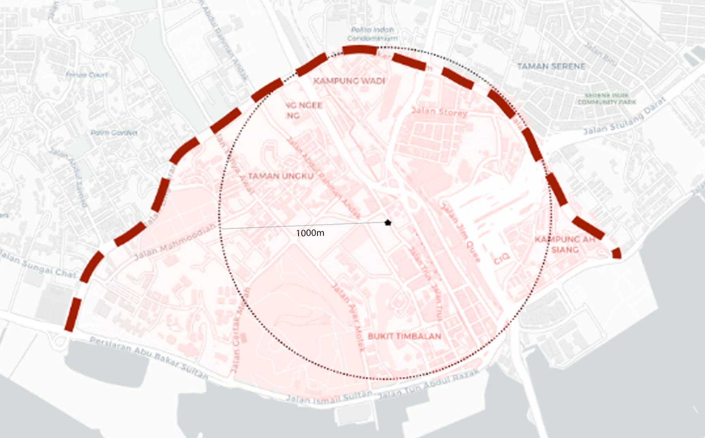
Scope of Study
Johor Bahru city center is chosen as a representative sample site to study the urban green coverage in Malaysia. It is chosen for its high density and its role being a central hub.
Details
Site selection | Johor Bahru city center
Site boundary | 1000m radius from JBCC Komtar
Collection date | December 2022
Data source | Google Street View

Slide 5
Significance of Study
The first study that investigates the urban green coverage from users’ perspectives in Malaysia.
The analysis on the distribution of urban green coverage inform the process of urban planning in terms of urban green space.
Compare different methods used to compute Green View Index (GVI) to find out the most effective method to do so.

Slide 6
Literature Review Overview
The gap in urban green space research in Malaysia
Significance and Calculation of Green View Index (GVI)
Models for the prediction of Green View Index (GVI)
Very few spatial studies on urban green space in Malaysia
Existing research focus only on aerial plan view in macro scale which cannot model typical human experiences in urban environment.
GVI is the most common metric used to study how much can people see green at their surroundings.
There are multiple variations in methods to compute GVI with different street view images collection configurations.
Unsupervised segmentation. Less accurate but resource saving.
Deep learning models. They have potential for higher accuracies, but are expensive. Susceptible to bias and variance if not well executed.
Notes:
Systemic review byRajoo et. al. in 2021: out of 43 records reviewed (PRISMA framework), only 4 of them were focused on the spatial analysis of urban green space
- Kasim et. al. (2019) published a study that documented the changes in urban green spaces between 2002, 2012 and 2017 with the use of high-resolution aerial imagery
Kanniah (2017) made use of time-series Landsat satellite imagery to monitor green cover changes in Kuala Lumpur from 2001 to 2016
Ludin and Rusli (2009) monitored the quality and distribution of open spaces in Johor Bahru Tengah Municipal Council with remote sensing data

Slide 7
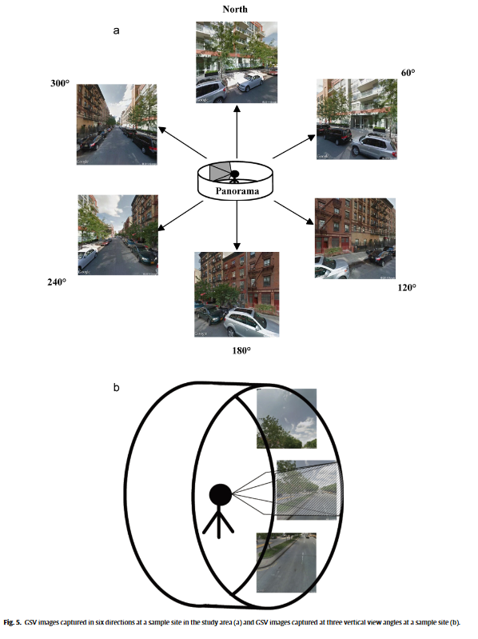
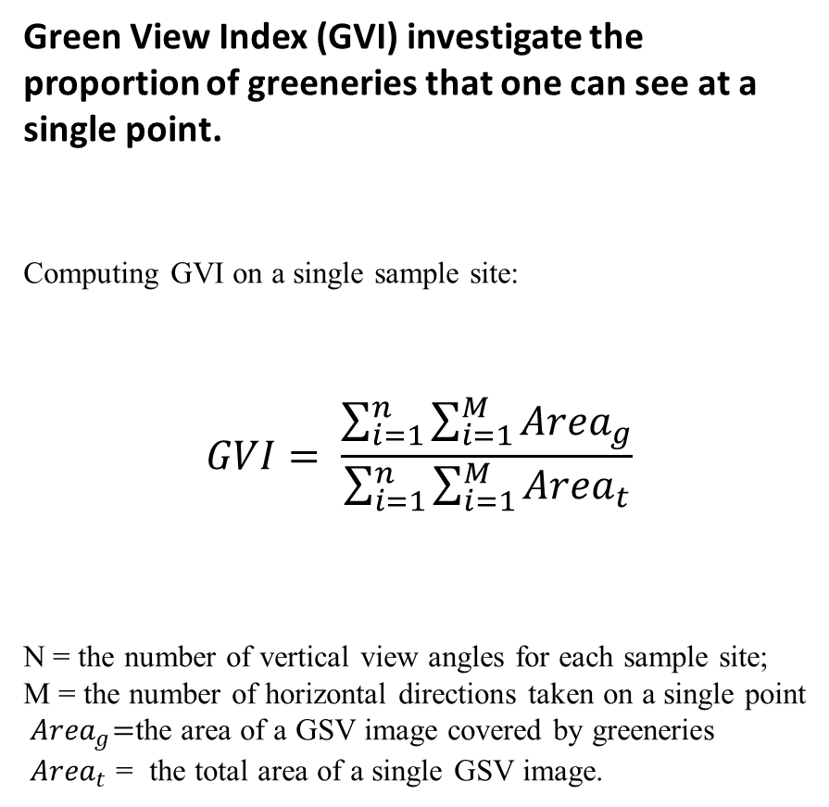
Calculating Green View Index (GVI)
Green View Index (GVI) investigate the proportion of greeneries that one can see at a single point.
Computing GVI on a single sample site:
$$GVI= \frac{\sum_{i=1}^{n}{\sum_{i=1}^{M}{{Area}_{g}}}}{\sum_{i=1}^{n}{\sum_{i=1}^{M}{{Area}_{t}}}}$$
N = the number of vertical view angles for each sample site; M = the number of horizontal directions taken on a single point
${ Area}_{g}=$the area of a GSV image covered by greeneries ${ Area}_{t}$ = the total area of a single GSV image.
Source: Assessing street-level urban greenery using Google Street View and a modified green view index (Li et. al., 2015)

Slide 8
Google Street Views (GSV) Configs for Data Collection
Configuration Name | Description | Discussion
GVI4 | GVI computed with 4 horizontal TSV images with heading angle of 90◦. (Long and Liu, 2017) | Greater numbers of headings allow for a lower field of vision (zoomed in), but also takes up more computational resources to compute.
GVI | GVI computed with 6 horizontal TSV images with heading angle of 60◦. (Zhang and Dong, 2018)
GVI8 | GVI computed with 8 horizontal TSV images with heading angle is 45◦ (Dong et. al., 2018)
GVI18 | Similar approach as method used by Li et. al. GVI computed with 6 horizontal TSV images with heading angle of 60◦ and 3 pitches for each heading. 18 images taken in total. (Li et. al., 2015) | Very comprehensive, but computationally expensive.
PGVI | GVI computed with cylindrical panorama stitched together from 6 horizontal TSV pictures. The distortion for PGVI might affect accuracy of GVI. (Cheng et. al., 2017) | Cylindrical panorama cause distortion in views.
Notes:
Dong et. Al. 2018 review of multiple street view configurations used by previous research.

Slide 9
Prediction Models for GVI
Unsupervised Segmentation Model
Detect green pixels algorithmically in street view images collected and compute its area over the area of whole image.
Pros: simple, no training required.
Cons: might factor in man-made green objects
Deep Learning Models
Manually masking the areas in image consisting of greeneries to generate ground truth to train supervised deep learning models that can detect areas consisting of greeneries.
Pros: able to achieve higher accuracy
Cons: long training time, ground truth generation subjects to human induced errors.

Slide 10
Comparison on Prediction Models
Model | Mean IOU (%) | Mean Absolute Error (%) compared with true GVI | Pearson Correlation Coefficient with true GVI | 5-95% of GVI Estimation Error | Output
Unsupervised Segmentation (Li et. al.) | 44.7 | 10.1 | 0.708 | -26.6, 18.7 | Pixel-segmented GSV image
DCNN semantic segmentation (Cai et. al., 2018) | 61.3 | 7.83 | 0.830 | -20.0, 12.37 | Pixel-segmented GSV image
DCNN end-to-end (Cai et. al., 2018) | NA | 4.67 | 0.939 | -10.9, 7.97 | Single GVI value between 0 and 1
HR-NetOCR (Zhang and Hu, 2022) | 80.6 | NA | NA | NA | Pixel-segmented GSV image
DeepLabV3+ (Xia et. al., 2021) | 78.37 | NA | NA | NA | Pixel-segmented GSV image

Slide 11
Research Framework
Phase 1: Problem Formulation1
Phase 2: Data Preparation
Phase 4: Interpretation and Report
Define field of interest and topic
Visualize GVI on study site.
Data collection from GSV
Data Preprocessing
Literature review
Descriptive Analysis on GVI values.
Convert to RGB
Ground Truth Generation
Formulate aim and objective
Clustering Analysis
Phase 3:Model Development and Evaluation
Define Scope of Study
Unsupervised Segmentation
(benchmark)
Deep Learning Models
Dashboard Development
Evaluate Accuracy (MAE, r, 5-95% Estimation Error)

Slide 12

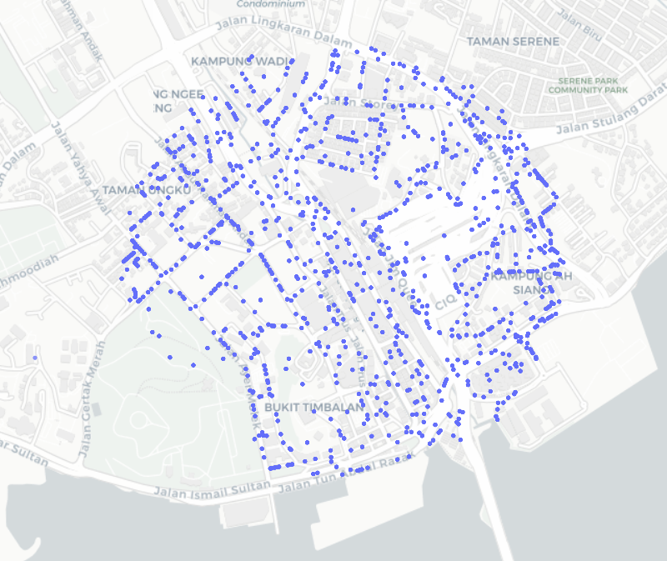
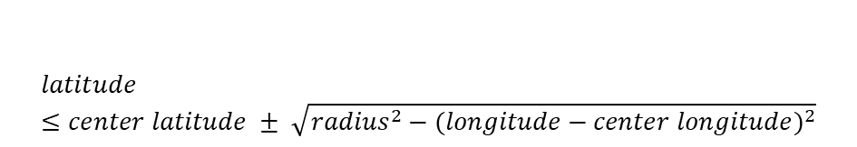
Data Preparation
Data Collection from GSV
1004 coordinates are selected randomly within the site boundary with formula derived from Pythagoras theorem:
$$latitude≤center latitude ± \sqrt{{radius}^{2}−{(longitude−center longitude)}^{2}}$$

Slide 13
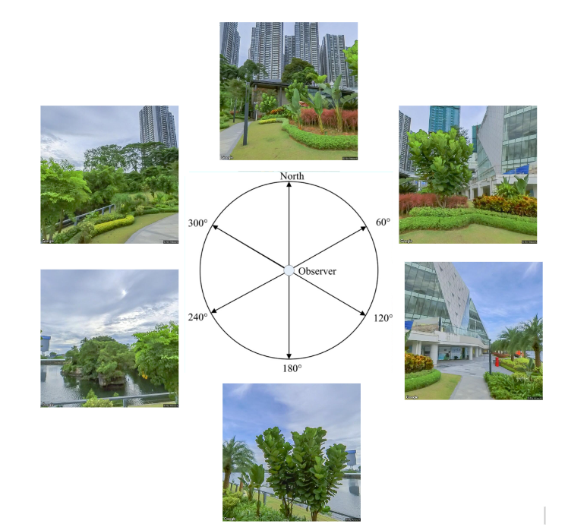
Data Preparation
Data Collection from GSV
At each sample point, images are taken at 6 different horizontal directions to capture every possible view. The parameters used to collect street view images at each sample site is displayed below:
For heading in [0, 60, 120, 180, 240, 300]: params = { 'key': api_key, 'size': '1280x1280', 'fov': 65, 'location': f'{latitude},{longitude}', 'heading': heading, 'pitch': 10
Sample view collected from a sample point at (1.4574946, 103.7690224)

Slide 14
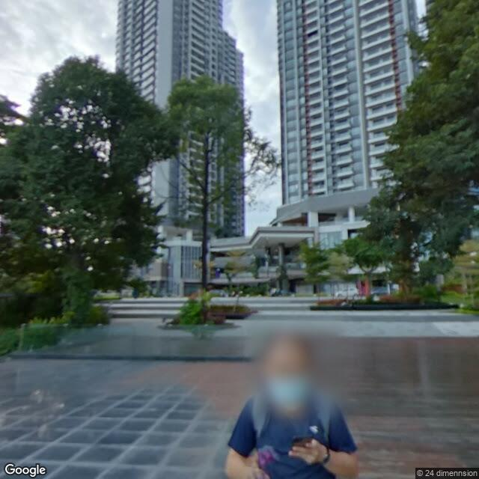

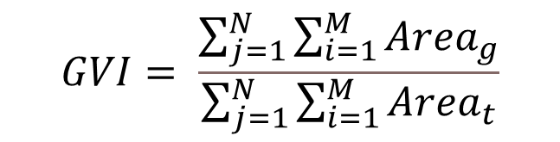
Data Preparation
Data Preprocessing
The collected street view images need to be converted to RGB format.
Ground truth is generated by masking the areas with greeneries and calculate GVI based on them.
$$GVI= \frac{\sum_{j=1}^{N}{\sum_{i=1}^{M}{{Area}_{g}}}}{\sum_{j=1}^{N}{\sum_{i=1}^{M}{{Area}_{t}}}}$$
True GVI is calculated for training and testing.
A sample of the street view image and its target mask.

Slide 15
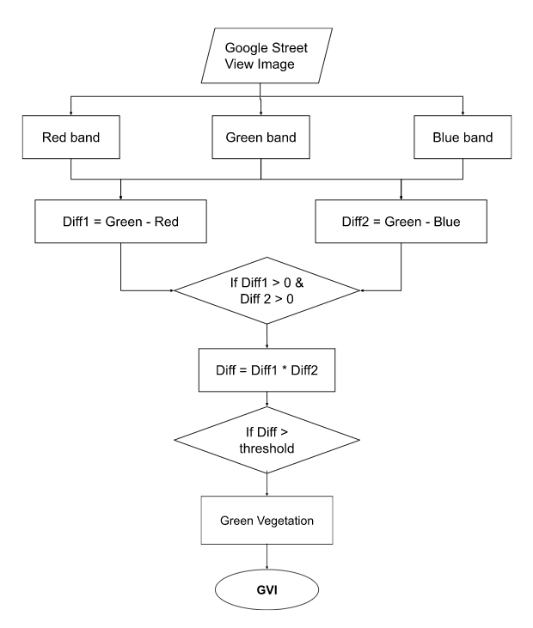
Model Development
Unsupervised Segmentation Model (Benchmark)
separate bands of red, green and blue are extracted from the RGB images.
differences are computed by subtracting the red band and blue band from the green band respectively. If both differences are larger than 0, they are multiplied to form a new Difference image.
To eliminate noise, a threshold is assigned such that selected pixels with value larger than threshold are mapped to value of 255 and those below mapped to 0.
The final outcome classifies the selected pixels as vegetation, while the others as not vegetation. After this, the GVI of an image can be easily calculated.

Slide 16
Model Development and Evaluation
Deep Learning Models
Collected Street View Data (training)
DCNN end-to-end model repository
Output Model
GVI
Fine-tuned
HRNet-OCR model repository
Output Model
Segmented image
Fine-tuned

Slide 17
DeepLabV3+ model
(ImageNet)
DCNN end-to-end model from repository
Cityscape data
Transfer learning
DeepLabV3+ model
(Cityscape)
GVI
Collected GSV Data
Transfer learning
Transfer learning
Output Model
Output Model
Predict
Predict
Model Evaluation
Model Evaluation
Fine-tune
Fine-tune

Slide 18
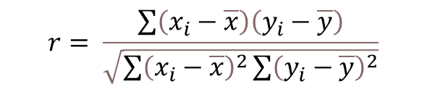
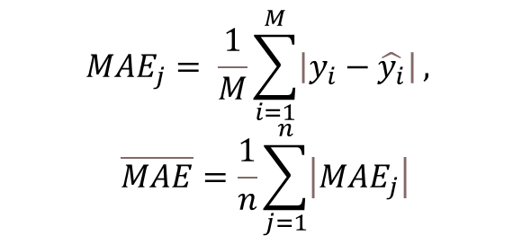
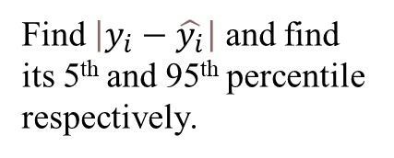
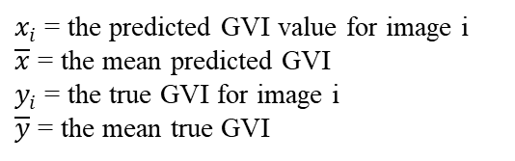
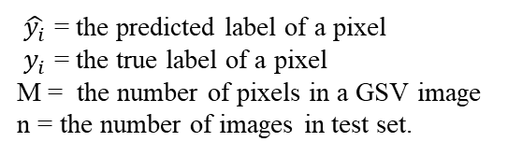
Model Development and Evaluation
Model Evaluation
The accuracies of models are measured with various metrics:
Mean absolute error
Pearson correlation coefficient ( r ) compared with true GVI
5-95% Estimation Error
$${MAE}_{j}= \frac{1}{M}\sum_{i=1}^{M}{\left|y_{i}−\hat{y_{i}}\right|},$$
$$\overline{MAE}=\frac{1}{n}\sum_{j=1}^{n}{\left|{MAE}_{j}\right|}$$
$$r= \frac{\sum{\left(x_{i}−\overline{x}\right)\left(y_{i}−\overline{y}\right)}}{\sqrt{\sum{{\left(x_{i}−\overline{x}\right)}^{2}}\sum{{\left(y_{i}−\overline{y}\right)}^{2}}}}$$
Find $\left|y_{i}−\hat{y_{i}}\right|$ and find its 5th and 95th percentile respectively.
$\hat{y_{i}}$ = the predicted label of a pixel
$y_{i}$ = the true label of a pixel
M = the number of pixels in a GSV image
n = the number of images in test set.
$x_{i}$ = the predicted GVI value for image i
$\overline{x}$ = the mean predicted GVI
$y_{i}$ = the true GVI for image i
$\overline{y}$ = the mean true GVI

Slide 19
Interpretation and Report
Document the accuracy of different models for GVI prediction
Predicted GVI are plotted on map to study the distribution of GVI in study site.
Exploratory analysis such as clustering analysis are conducted to determine the underlying patterns that might lead to the difference in GVI value.

Slide 20
Initial Findings
Accuracy of Prediction Models
Model | Mean Absolute Error (%) | Pearson Correlation Coefficient with true GVI ( r ) | 5-95% of GVI Estimation Error
Unsupervised segmentation model | 7.31 | 0.909 | -0.115, 0.183
DCNN end-to-end (initial weights without further training) | 14.67 | 0.893 | -0.357, 0.073
DCNN end-to-end (trained) | To be further trained | To be further trained | To be further trained
HRNet-OCR model | To be further trained | To be further trained | To be further trained
Observation:
The benchmark unsupervised segmentation model perform better than the pre-trained DCNN end-to-end model.

Slide 21
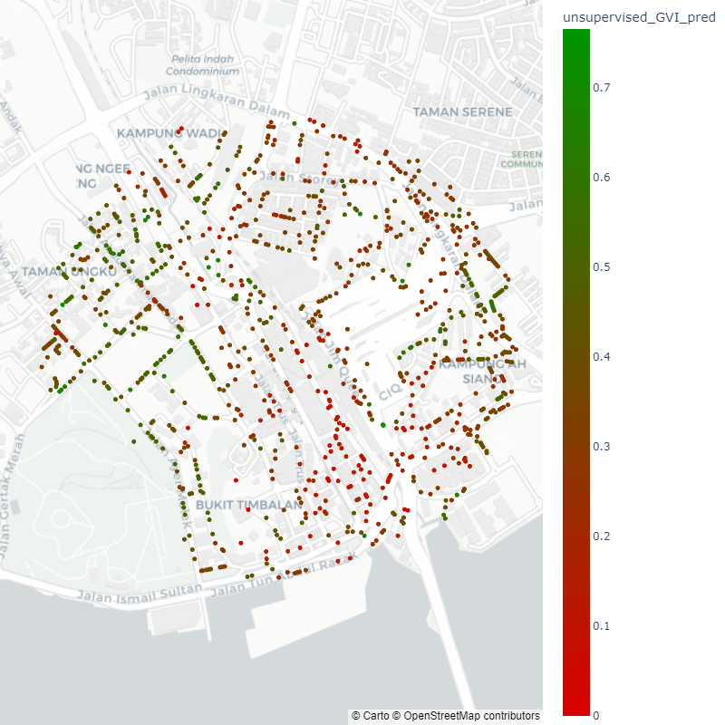
Initial Findings
Visualization and Analysis
The redder the plot, the lower the GVI. The greener the plot, the higher the GVI.
Observations:
GVI values in the study site vary due to their locations.
the East side of the study site appears to have lower GVI values than the West.
the South-East part of the site has the highest density of red points with low GVI
GVI predictions based on unsupervised classification visualized.

Slide 22
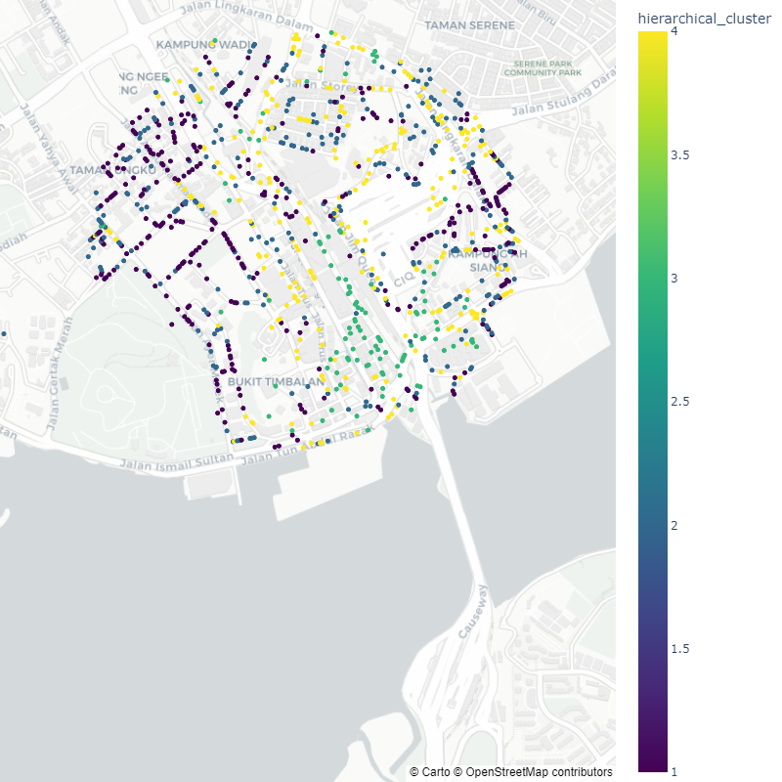
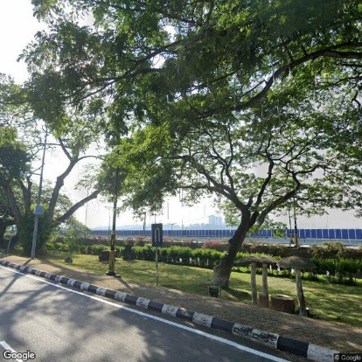
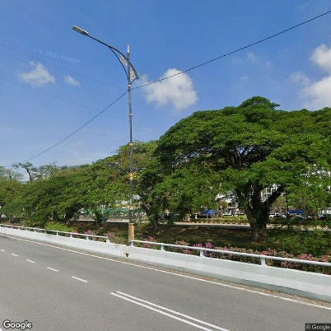
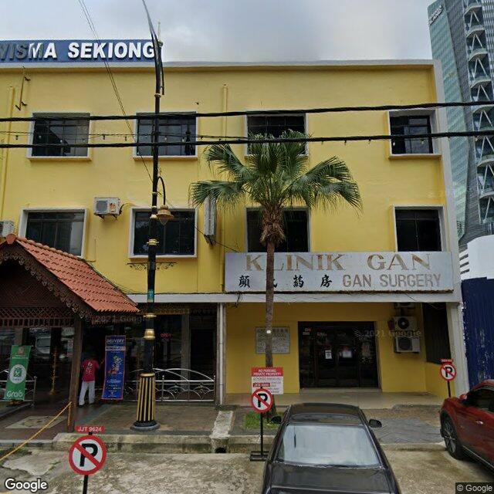
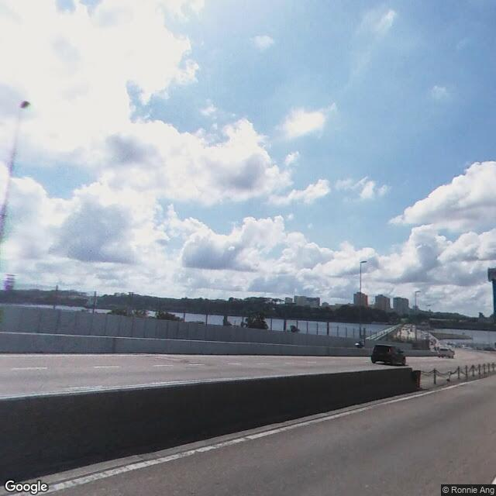
Initial Findings
Clustering Analysis
Data points are clustered hierarchically based on their locations and predicted GVI.
Observations:
hierarchical_cluster | unsupervised_GVI_pred
1 | 0.492871
2 | 0.342162
4 | 0.241678
3 | 0.114488
Representative image of each cluster.
Visualization of hierarchical clusters.

